Slide 1
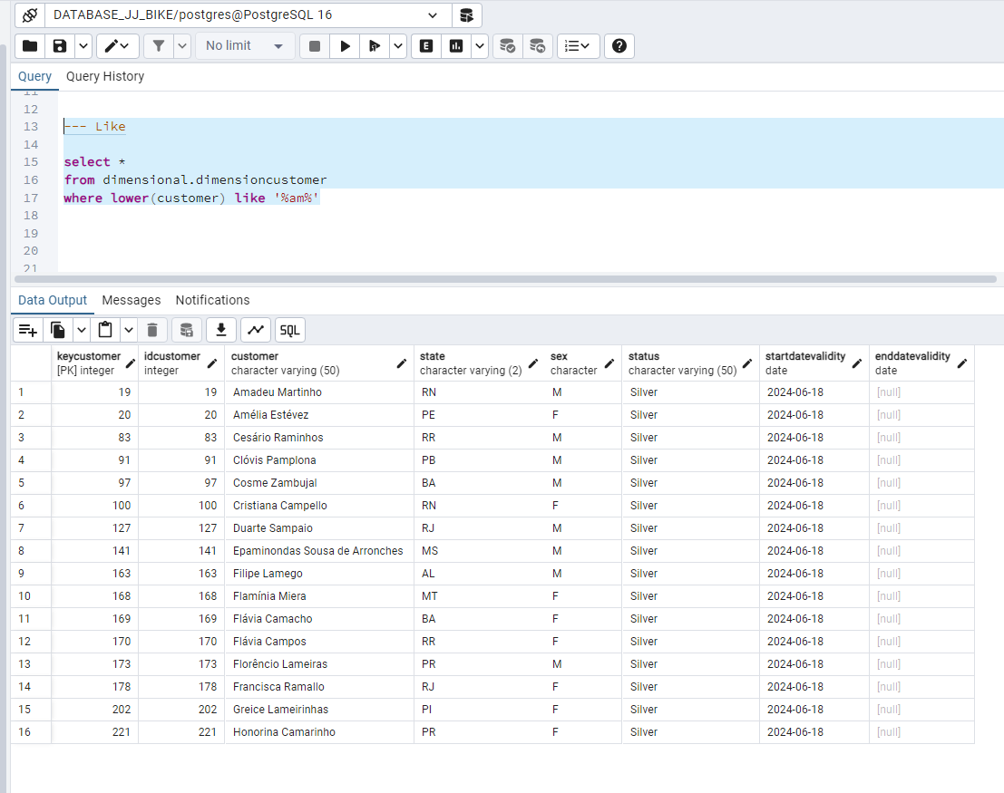
Queries SQL Languages - Examples
Customer Relational Database Query Table – example 1
On the left side we can see an example, using the "like" command is used to search text, this command uses the %% operator between the keyword we are looking for, in this case we search and bring all customers that have "am" in any part of your name.
The like command is used to search using masks such as %,* etc. It is used as an aid to search more precisely. The "lower" command puts all words in lower case because the search engine is case sensitive and in this case this command keeps all words in the same pattern and so we can search with everything in lower case.

Slide 2
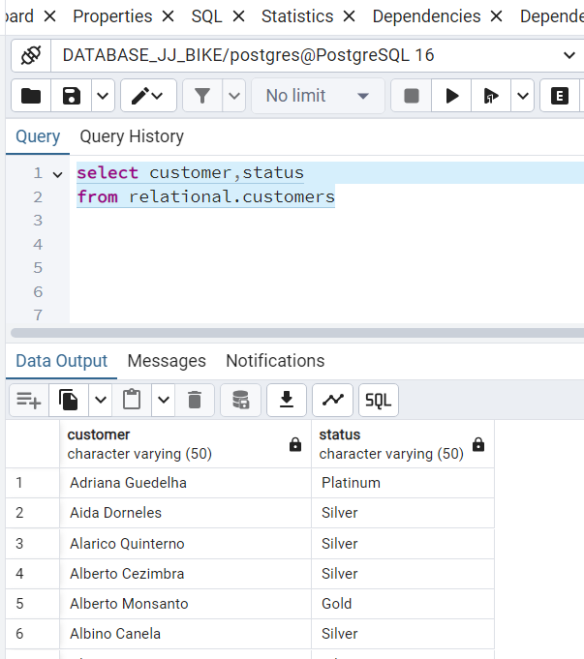
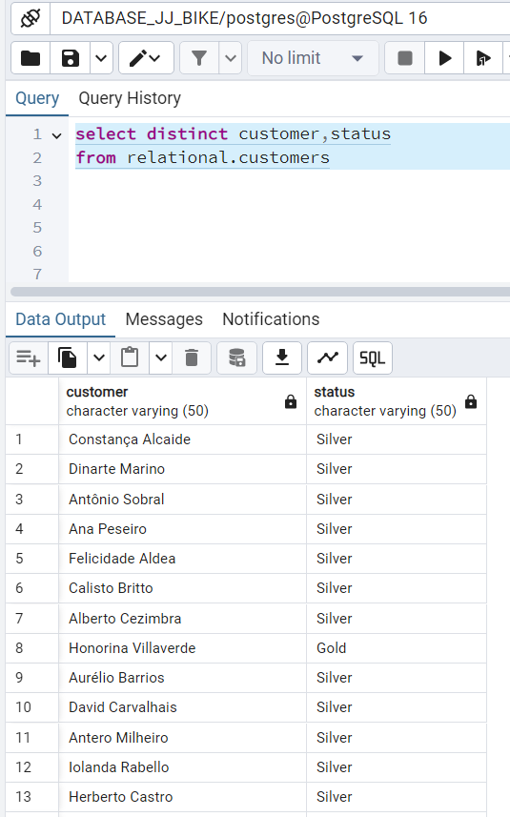
Queries SQL Languages - Examples
Customer Relational Database Query Table – example 2,3
Named columns only bring data from those selected columns
Using the "Distinct" command removes duplicates from the returned data

Slide 3
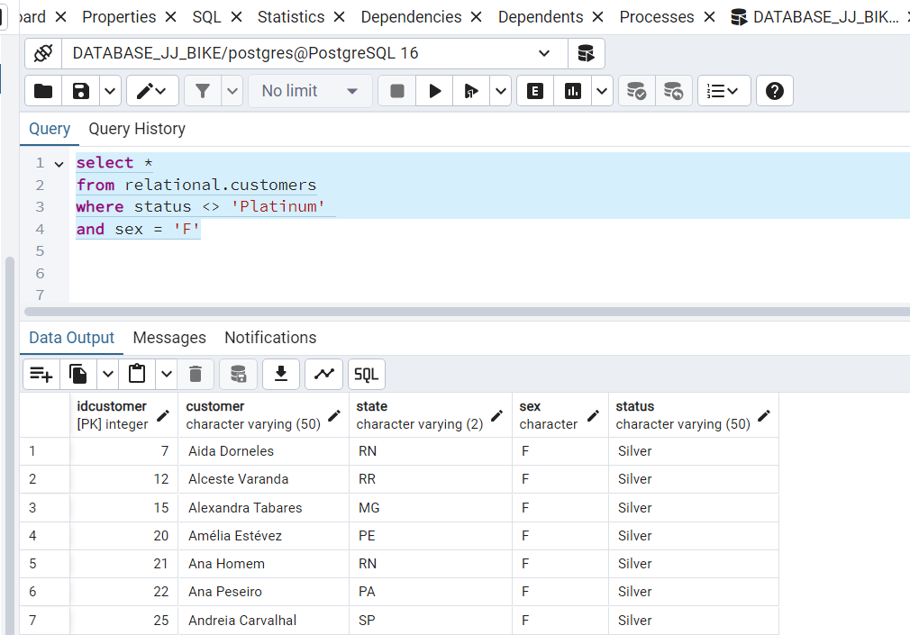
Queries SQL Languages - Examples
Customer Relational Database Query Table – example 4
On the left side we can see a query on the customer table in the relational database with two conditions, in this case it will show data from all columns due to the use of the "*" symbol having been placed after the "select" command, if the column names were written it would bring only them.
And it will only bring data when the column status is different from ''Platinum" and Sex is equal to "F", only data that satisfies both conditions simultaneously will be brought. This is because the "e" command was used in the second condition

Slide 4
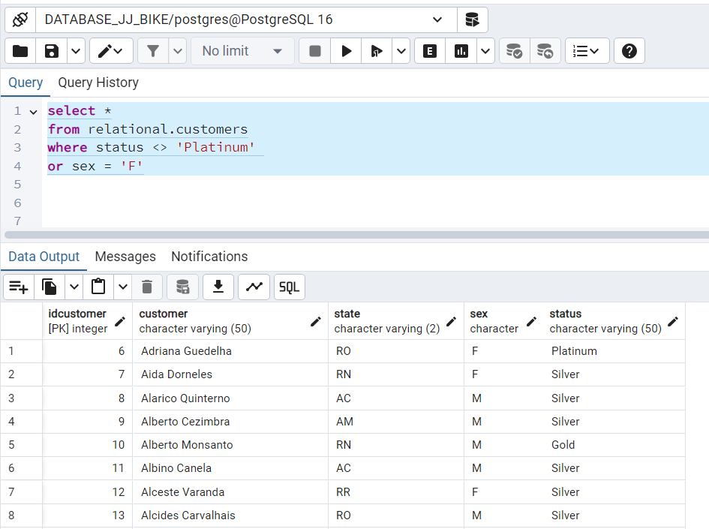
Queries SQL Languages - Examples
Customer Relational Database Query Table – example 5
On the left side we can see a query on the customer table in the relational database with two conditions, in this case it will show data from all columns due to the use of the "*" symbol having been placed after the "select" command, if the column names were written it would bring only them.
And it will only bring data when the column status is different from ''Platinum" or Sex is equal to "F", only the data that individually satisfies each condition will be brought and not both simultaneously. This is because the "or" command was used in the second condition. For example, you can have "gold" information for status and "F" information for sex, or "Platinum" information for Status and "M" information for Sex.

Slide 5
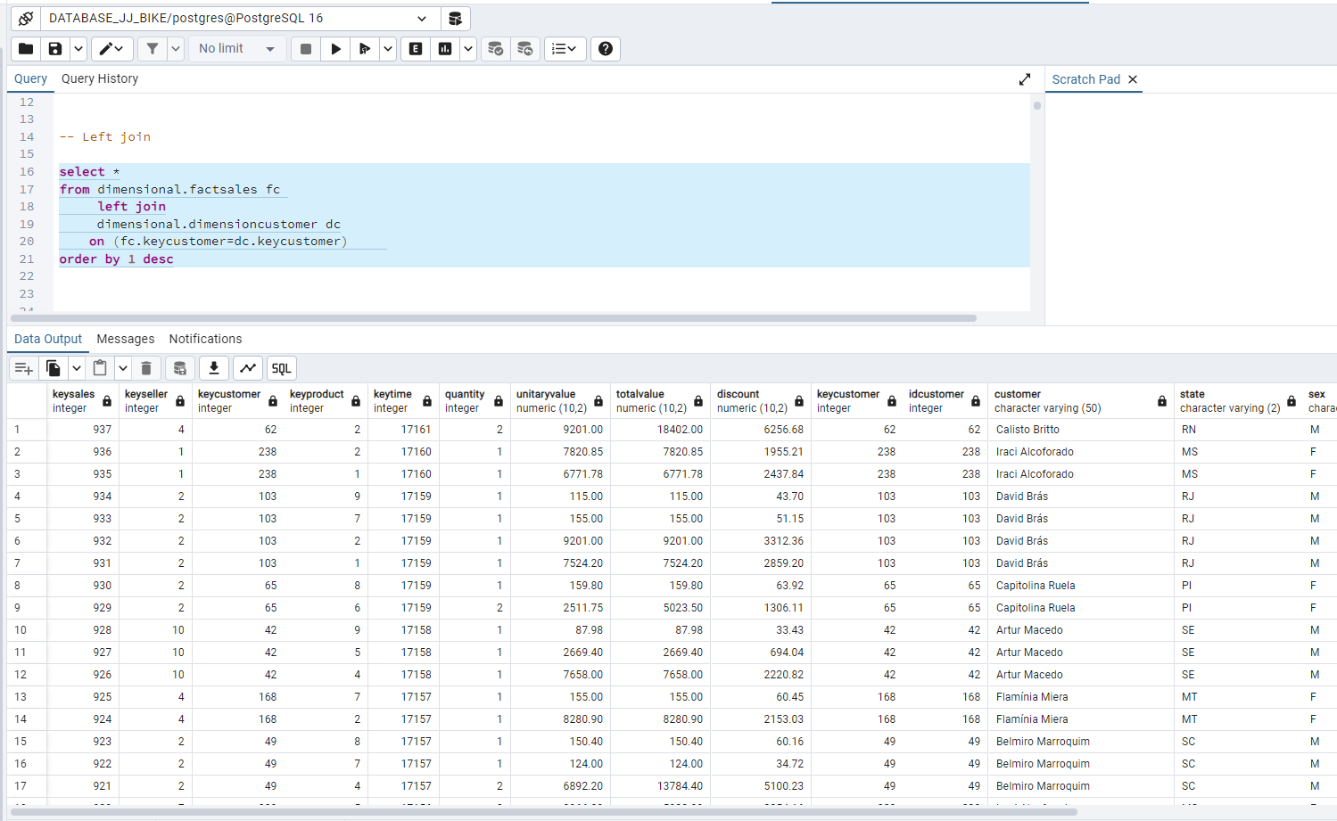
Queries SQL Languages - Examples
Query in Dimensional Database Query Table – example 6
On the left side we can see an example of using the "left join" command. This command brings all the data from table A (FactSales), and only the corresponding data from table B (dimesioncustomer) determined by the link through the keycustomer field.
In this case, it will not bring any null field, as it is only allowed in the database due to restriction rules to only register sales from a previously registered seller and customer.

Slide 6
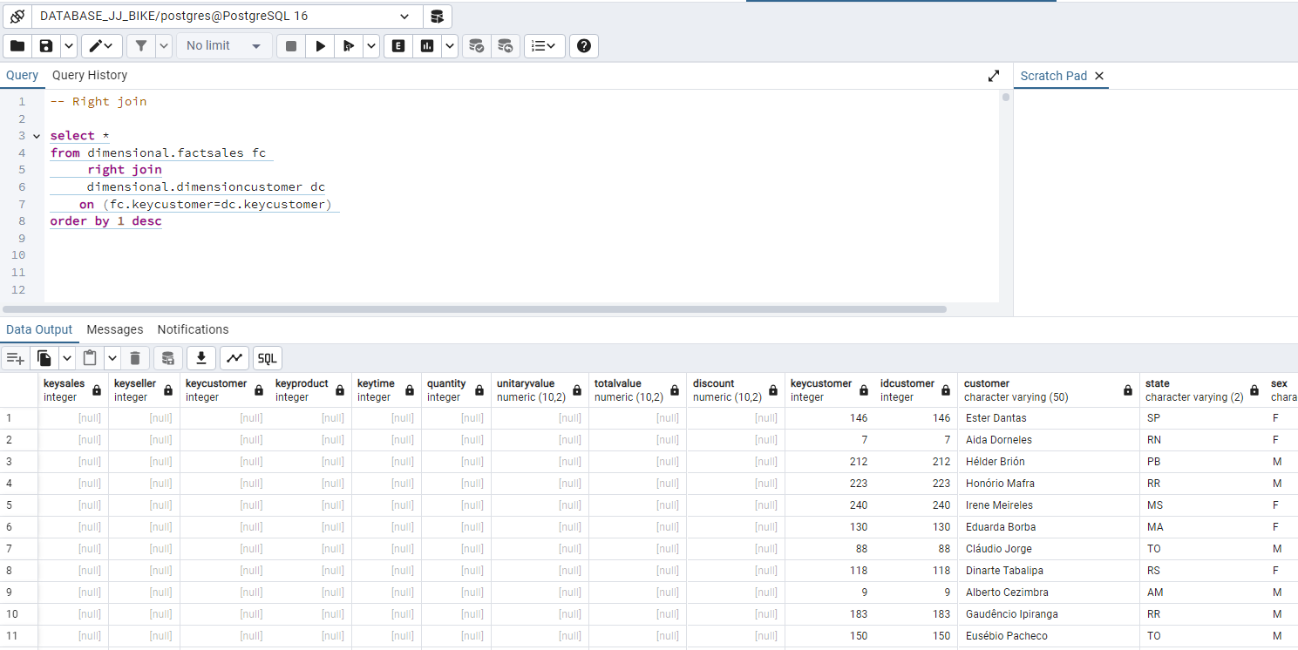
Queries SQL Languages - Examples
Query in Dimensional Database Query Table – example 7
On the left side we can see an example of using the "right join" command. This command brings all the data from table B (dimesioncustomer), and only the corresponding data from table A (FactSales) determined by the link through the keycustomer field.
In this case, the fields are empty, they are records that do not exist in the FactSales table, but exist in the dimesioncustomer table, which means that there are several customers who have not yet made any purchases, but are already registered in the database.

Slide 7
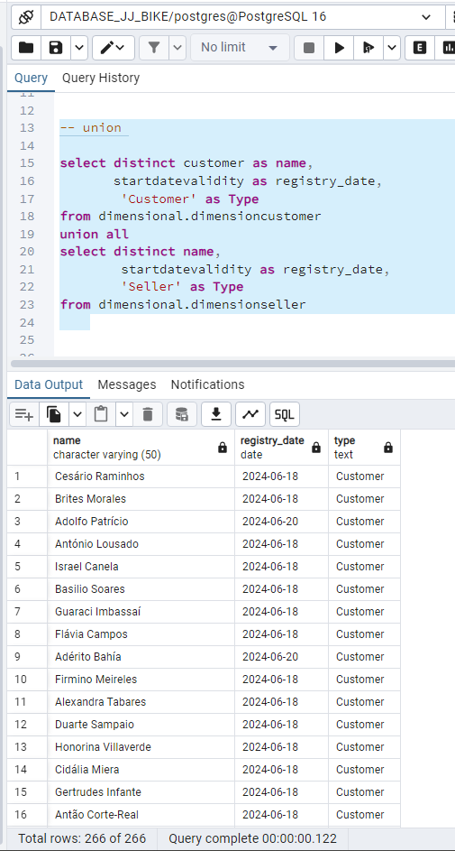
Queries SQL Languages - Examples
Query in Dimensional Database Query Table – example 8
On the left side we can see, the command use "Union all", this command creates a new recordet containing data from both dimensioncustomer and dimensionseller tables.
The objective here is to create a recordset containing all customer and salesperson records, in this case both queries need to contain the same number of columns and the same type of data, we use the "distinct" command in advance to bring up unique records in both tables.
There are two commands "union" and "union all", the first removes duplicates, the second and no, but as the second is faster it is better to use the second command and treat duplicate records in each query individually using the "distinct" command " . The origin of the table's record is maintained in the "type" field, which identifies whether the record belongs to the seller or the customer

Slide 8
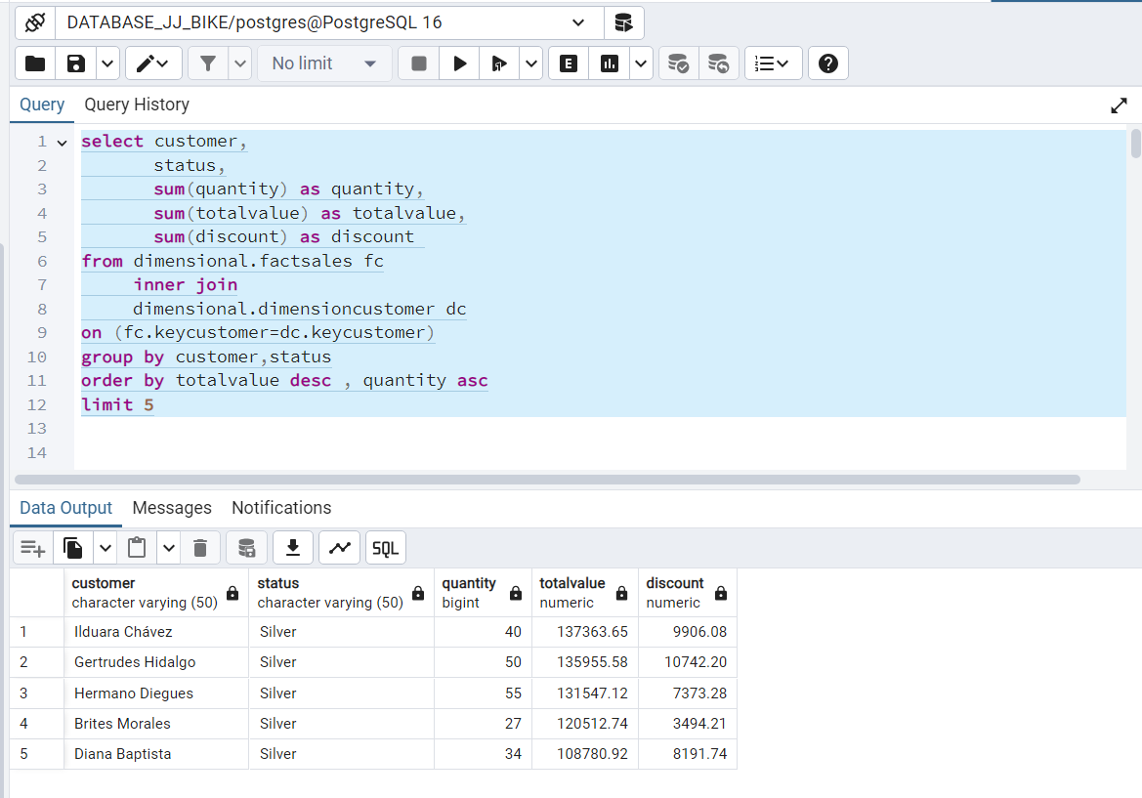
Queries SQL Languages - Examples
Query in Dimensional Database Query Table – example 9
On the left side you can see the "inner join" command to join two tables "factsales" and "dimesioncustormer" , to create a connection with these two tables the "on" command is used and the names of two columns are used in both the tables to make the link, in this case the “keycustomer” field in the dimensional database was used as a key, this like follows the logic of dimensional modeling.
The "inner join" command determines the relationship between the two tables, in this case it only shows records where the keycustomer field, which is the link between them, is the same in both tables.
Columns were selected using the "select" clause to bring up specific fields such as “customer, status, quantity, totalvalue and discount”.
We can observe the use of the aggregate columns command, in this case the "sum" command was used to add the values ​​of these columns such as "quantity, total value and discount", in this case it is necessary to place the unused grouped fields in the "sum" command as customers and status in the "group by" command, for the database to do the aggregated sum for these column levels.
The "sort by desc" command for the "totalvalue" field puts the table in descending order from this field starting from highest to lowest this is the first sort, the second sort is the "asc" command means sort by order ascending through the "discount" field, starting from the smallest to the main one, the database system will follow the order logic by ordering the first column and then the second.
The "Limit 5" command brings only the first 5 records, in this case as the first ordering is the "total value" field brings the first 5 customers who had the most purchases in the entire dimensional database

Slide 9
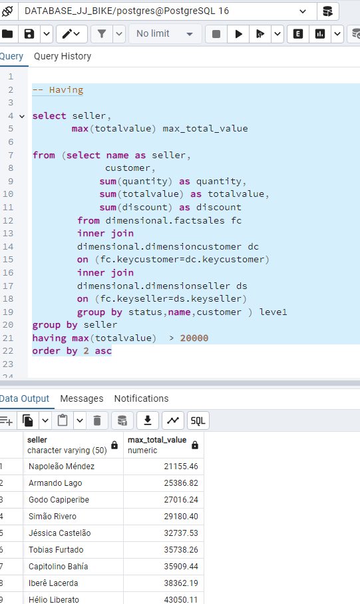
Queries SQL Languages - Examples
Query in Dimensional Database Query Table – example 10
On the left side we can see the use of the "having" command. This type of command is used to filter data into aggregates of fields like sum, maximum, minimum, average etc.

Slide 10
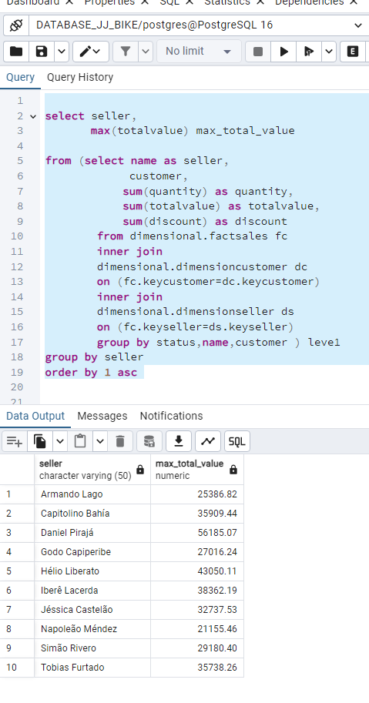
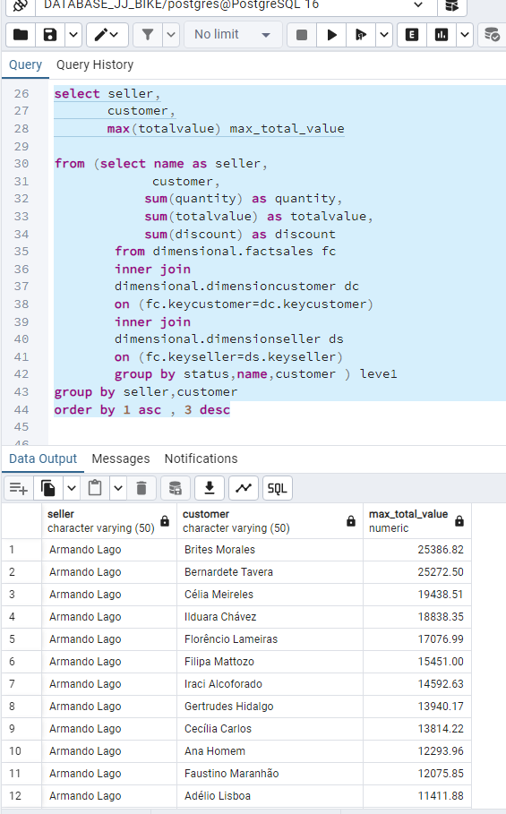
Queries SQL Languages - Examples
Query in Dimensional Database Query Table – example 11 and 12
In the left side we can see one example used to command max , in this case is showing the biggest sales by seller.
On the right side, we can confirm the information from the previous query, for the seller Armando Lago the biggest sale was to the customer Brites Morales with the value 25386.82

Slide 11
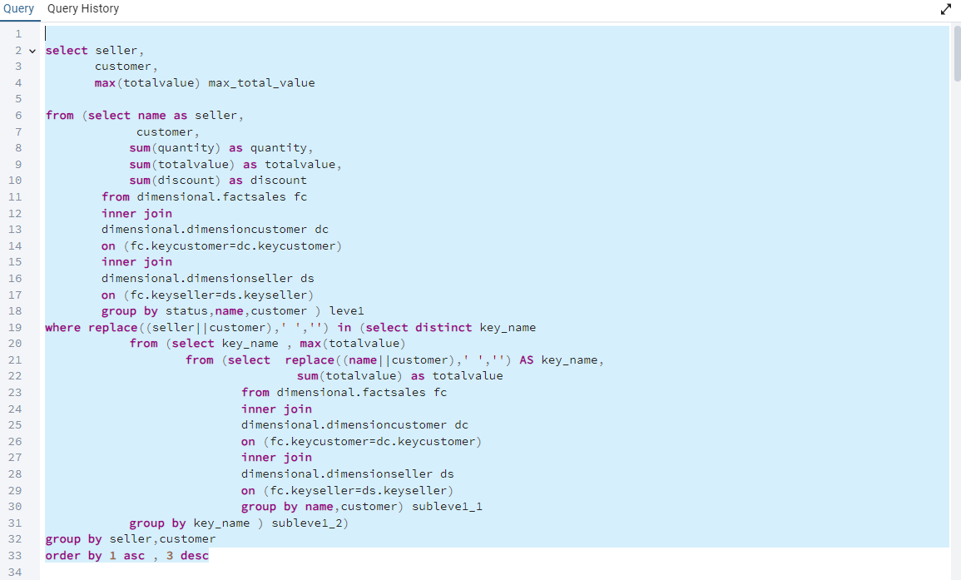
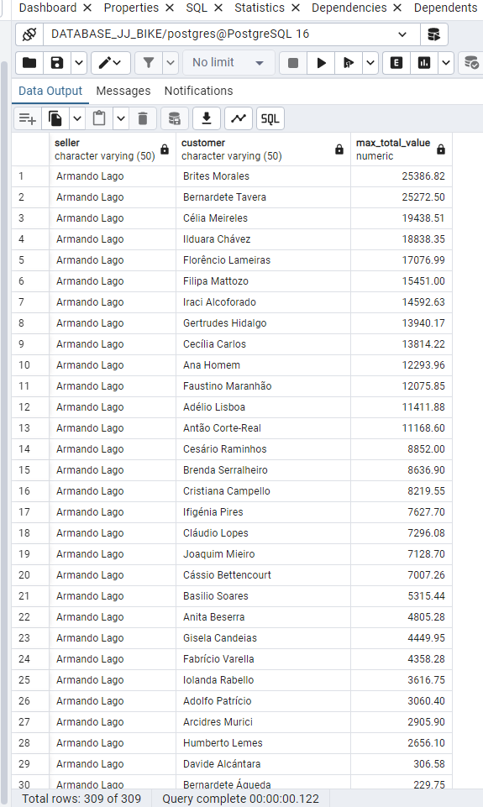
Below we have a query and its result, here we have the result of the total sales grouped by salesperson and customer, and the "max" command was used to get the biggest salespeople, however as it is grouped by customer here it is bringing all sales of all customers of each seller, to bring only one customer per seller in this case, only the customer who had the biggest sale for each seller, we will apply a filter and this will be demonstrated in example 9 then we will only have the list of the best customer for each seller .
Queries SQL Languages - Examples
Query in Dimensional Database Query Table – example 13

Slide 12
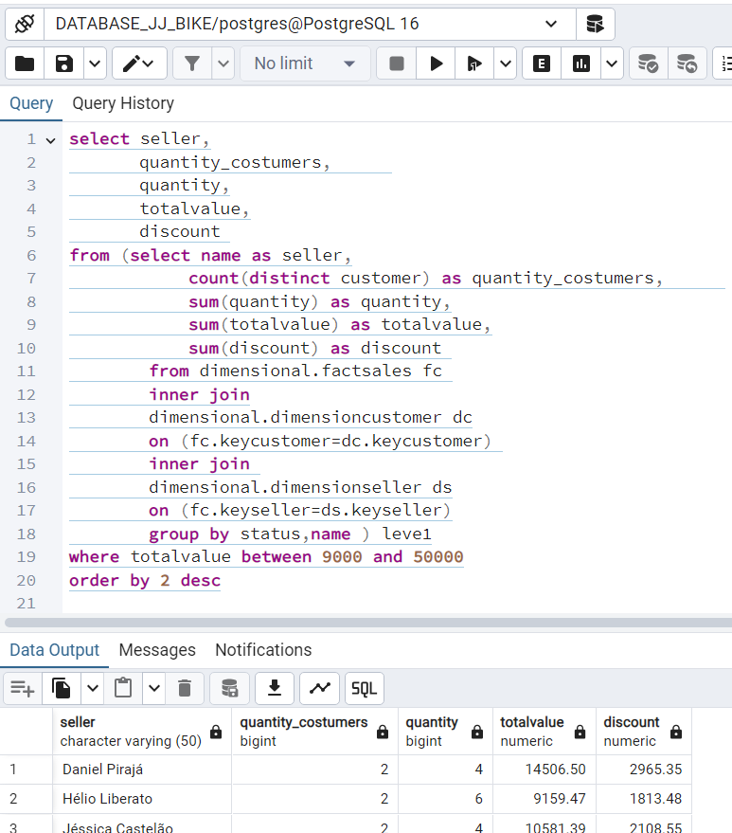
Queries SQL Languages - Examples
Query in Dimensional Database Query Table – example 14
In the example we use two queries together, called query and sub-query, the first is an internal sub-query that is used to make the aggregations.
The example in sub-querie shows the use of the command "count(distinct )" this command counts the unique records for the "customers" field, in this case this field is not used in the "group by" clause, as it is used to calculate this aggregation, the final result shows the number of customers per salesperson in the entire database in the dimensional model.
The external query is used to make a filter selecting a value range between 9000 and 50000 in the “totalvalue” column and to do the sorting.
The "order by 2 desc" command puts the table in order using the second column of the columns shown, in this case it is "quantity_customer" and puts it in order from largest to smallest.

Slide 13
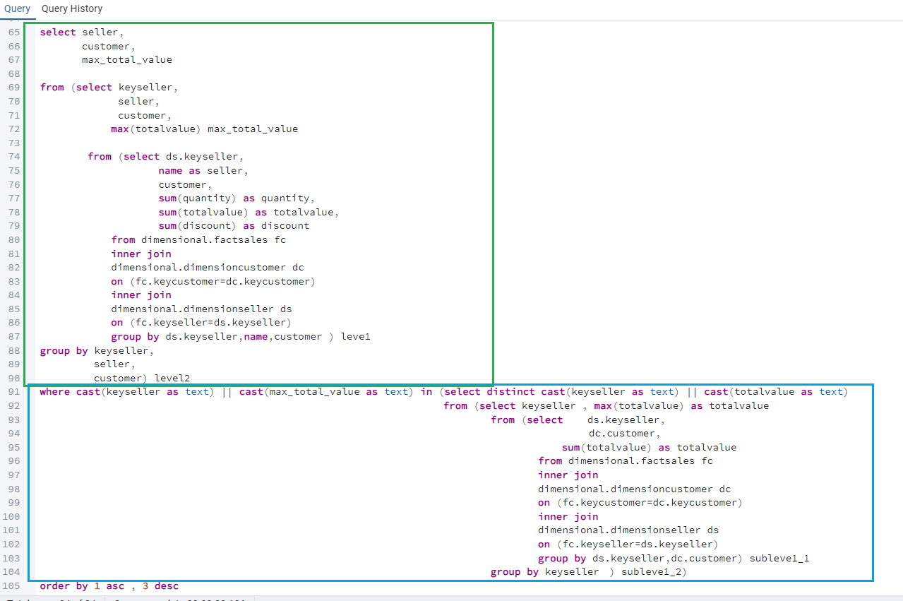
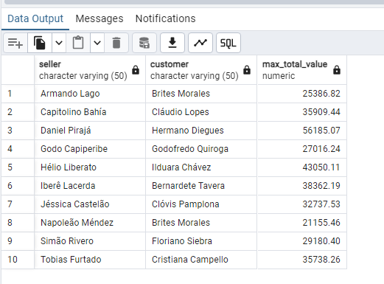
Queries SQL Languages - Examples
Query in Dimensional Database Query Table – example 15
Below highlighted in green, we can see 3 queries together, a main query and two subqueries, the objective of this query is to make aggregations at the correct level, in the first aggregation in the center of the query, we use the total aggregate sum of sales for customer and seller. In the second subquery we use the max command on total sales (the highest value of each aggregation), aggregated by salesperson and customer. And in the last query we list all the relevant fields, which the system will show in the visualization.
In the yellow highlight we can see a query containing some subqueries, the objective is to select the maximum sales value for each customer in the entire database by salesperson, and use the unique key to identify these records and pass this data as a filter to the main query in blue highlight. Note that it was necessary to create a unique key in both queries to make this selection work correctly.
Below we have the final result of the query, in this case it shows all sellers, and shows the best customer for each seller, the customer who purchased the most and shows the total sales of this customer.

